Slide 1
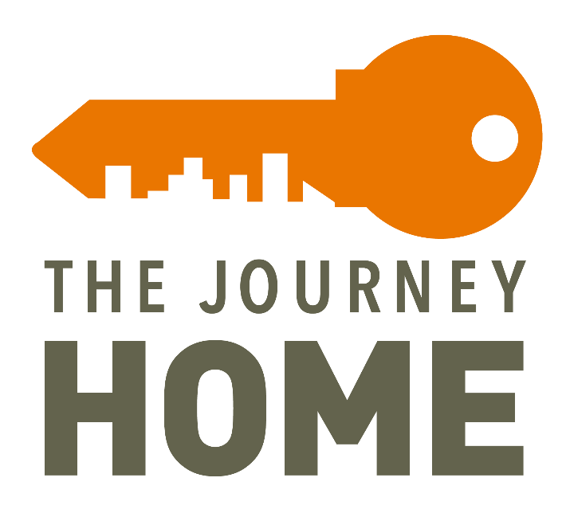
YOUTH
HOMELESSNESS
DEMONSTRATION
PROGRAM
Request for Proposals
Crisis - Bridge Housing
Webinar
August 10, 2020

Slide 2
Housekeeping
Webinar is being recorded and will be posted along with the slides and FAQs to the MOHS website.
All attendees are muted to prevent background noise.
Questions will be answered at the end of the webinar. To submit a question, use the box to the right
Only questions about the competition process and the applications will be answered during this webinar - if you have a specific question about your project, please send it to HSPApplications@baltimorecity.gov.

Slide 3
YHDP Overview
#BmoreYHDP

Slide 4
Purpose of YHDP
To support communities in the development and implementation of a coordinated community approach to preventing and ending youth homelessness

Slide 5
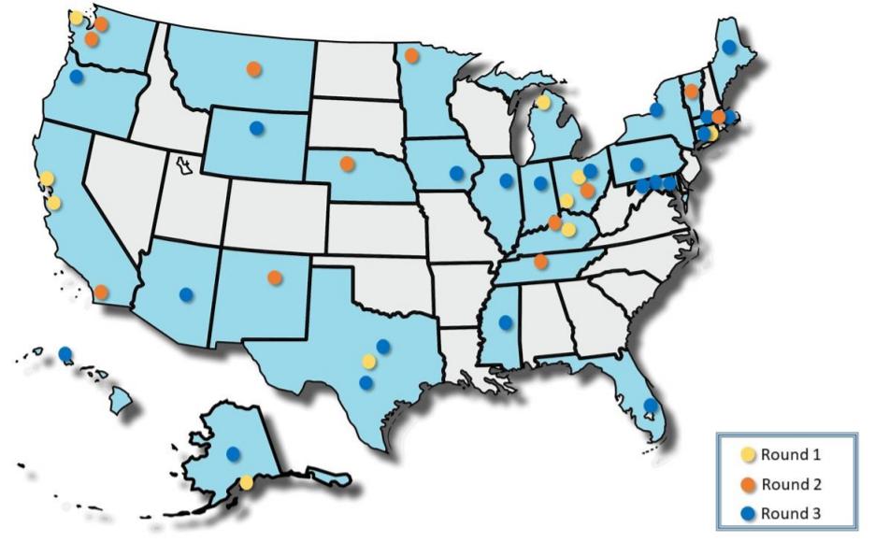
Youth Homelessness Demonstration Project
August 2019, Baltimore city was Awarded $ 3.7 million as a round 3 YHDP recipient community.
September 2019, MOHS convened local stakeholders for a kickoff meeting and released correspondence to Continuum of Care members to announce the launch of a YHDP Planning Committee.
March 2020, the Youth Homelessness Action Committee and Youth Action Board completed the YHDP system modeling and selected 5 projects
Re-housing
Permanent Supportive Housing
Family based setting
Diversion
Transitional Housing (Crisis Bridge Housing)
#BmoreYHDP
Notes:
23 communities awarded $75 mil total
Participation has included attendance at meetings twice monthly, as well as monthly full-day planning sessions with the technical assistance team

Slide 6
YHDP Technical Assistance
Baltimore’s TA:
Our community will be supported by a team of technical assistance providers:
CSH – Lead TA Agency
True Colors – Youth Engagement
Partnership Center – Data
National Center for Homeless Education – Education Partnerships

Slide 7
YHDP Key Elements
Coordinated Community Plan (CCP)
A community wide plan on preventing and ending youth homelessness in Baltimore that includes comprehensive strategies beyond the YHDP grant funding
Includes key system partner goals including, education, employment, child welfare, justice, and behavioral and physical health
Incorporates a set of values and principles including trauma informed care, positive youth development, family engagement, and youth choice
Youth Action Board (YAB)
A decision-making body consisting of consisting of youth and young adults with lived experiences of housing instability and homelessness
HUD requires the creation of a Youth Action Board. The board must have decision making ability within the grant’s governance, and approve the plan and the YHDP-funded projects
YAB is part of approving, selecting and providing feedback for YHDP projects.
YHDP Projects
Federal grant dollars from the U.S. Department of Housing and Urban Development (HUD)
2-year grant; renewable on an annual basis as part of the CoC competition

Slide 8
YHDP Eligibility
#BmoreYHDP

Slide 9
Eligible Applicants
To be considered a qualified organization, the applicant must meet the following mandatory criteria:
Non-Profit 501(c)(3) tax-exempt organization or another city government agency
Be located or provide services in Baltimore City
Commitment to operating the program under the Housing First model
At least a 25% cash or in-kind match for the amount of funding requested.
Applicants may submit joint applications in response to this RFP, with one as the lead agency recipient and another as a subrecipient. Joint applications should submit an MOU reflecting the role of project partners and specify funding for each organization in the budget section.
#BmoreYHDP
Notes:
Any applications with missing documents, will not pass threshold and not be scored.

Slide 10
Threshold Criteria
The following elements are required but not scored – if response is “no”, the project is ineligible. The supporting documents are needed with submission:
Supporting Documents needed with submission:
Federal Tax Exempt Determination Letter
Articles of Incorporation & Bylaws
Current Certificate of Good Standing from State of Maryland
Current list of Board of Directors
Project Organizational Chart
Most Recent A-133 or Independent Financial Audit
Proof of Ownership or Lease Agreement (Only for Project-Based projects)
Match Documentation (We encourage agencies to apply whether or not they can document the full 25% match and demonstrate the extent to which they can provide match)

Slide 11
Threshold Criteria
The following must be completed and signed to move to the review and scoring phase:
One (1) complete application in PDF with required signatures submitted by deadline
Budget Workbook & Narrative
MOHS Fair Housing Policy Statement and Agreement
MOHS Housing First Policy Agreement
Conflict of Interest Questionnaire and Limits to Primary Religious Organizations

Slide 12
Match Requirement
At least 25% cash or in-kind for for the amount of funding requested
The subrecipient must match all grant funds, except for leasing funds, with no less than twenty-five percent (25%) of funds or in-kind contributions from other sources in accordance with 24 CFR § 578.73.
All CoC Program costs and match sources must be in your approved budget
Match does not have to be used on the same budget line item as the grant funding, but does need to be used on activities for the project that otherwise would have been eligible to be funded with CoC Program funds
Match must be committed prior to grant agreement
Recipients must document all costs paid with match throughout the period of the YHDP grant
Notes:
See Appendix D for more details on match requirement and documentation

Slide 13
Eligible forms of Match
Cash
A recipient or subrecipient may use funds from any source, including any other federal sources (excluding Continuum of Care program funds), as well as State, local, and private sources, provided that funds from the source are not statutorily prohibited to be used as a match
Used to cover costs that would have been eligible to be paid for with CoC Program funds
In-kind Contributions
Services and goods
Used to cover costs that would have been eligible to be paid for with CoC Program funds
Notes:
See Appendix D for more details on match requirement and documentation

Slide 14
Populations Served
#BmoreYHDP

Slide 15
Funds under YHDP can serve:
Youth and Young Adults (YYA) at-risk of and experiencing homelessness. Youth are minors under the age of 18, and young adults are aged 18-24 (up to 25). This also includes YYA who are pregnant and/or caring for one or more children, including the care of minor siblings.
What does it mean to experience homelessness?
Experiencing literal homelessness – living on the streets, in cars, places not for human habitation, or shelters (HUD Category 1)
At imminent risk of homelessness – within 14 days of losing their housing (HUD Category 2)
Fleeing unsafe situations – any situation a youth declares unsafe and wants to leave, including abusive (physical and emotional), non-LGBTQ affirming, drug/alcohol, sexual exploitation (HUD Category 4)

Slide 16
Target Population
Special efforts should also be made to serve YYA including:
LGBTQ+
Unaccompanied Minors*
Pregnant and Parenting Youth
Youth of Color
Foster Care Involved
Justice Involved
Survivors of Trafficking and Exploitation
Immigrant and Undocumented Youth

Slide 17
Unaccompanied Minors
Effective July 1, 2020, Maryland enacted HB 206 ; Unaccompanied Minors in Need of Shelter and Supportive Services.
Law gives unaccompanied or youth at risk of experiencing homelessness the legal capacity to consent to shelter, housing, and supportive services without parental consent.
Any public or private nonprofit organization that provides shelter or supportive services to minors in need of shelter must register with the Maryland Department of Housing and Community Development.
DHCD will annually certify that providers meet certain conditions, including running background checks on employees, providing mandatory reporting training for employees, and requiring service providers to develop and implement procedures to screen staff members who work with minors.

Slide 18
Guiding Principles
#BmoreYHDP

Slide 19
YHDP Guiding Principles
1: USICH Youth Framework and Four Core Outcomes
2: Respond to the Needs of Special Populations
3: Equity
4: Positive Youth Development and Trauma Informed Care
5: Family Engagement
6: Immediate Access to Housing with No Preconditions
7: Youth Choice
8: Individualized and Client-Driven Supports
9: Social and Community Integration
10: Coordinated Entry
See Baltimore City Coordinated Community Plan, pgs. 19-26
#BmoreYHDP

Slide 20
YHDP Guiding Principles
Equity
Both national and local reports and ongoing HMIS analysis indicate significant racial disparities within the homeless service system and across other systems. The disproportionality in risk for these groups is so great that the data in and of itself provides hard evidence that systems, not individuals, are what perpetuate homelessness. The SPARC study, a groundbreaking study by the Center for Social Innovation, makes the link between systemic racism and homelessness even more explicit by demonstrating that that the disproportionality of experiences of homelessness by race, even when controlling for poverty levels, is so severe that it indicates that homelessness likely has more to do with racism than it does poverty.
#BmoreYHDP

Slide 21
YHDP Guiding Principles
USICH Youth Framework and Four Core Outcomes
Stable housing includes a safe and reliable place to call home.
Permanent connections include ongoing attachments to families, communities, schools, and other positive social networks.
Education/employment includes high performance in and completion of educational and training activities, especially for younger youth, and starting and maintaining adequate and stable employment, particularly for older youth.
Social-emotional well-being includes the development of key competencies, attitudes, and behaviors that equip a young person to succeed across multiple domains of daily life, including school, work, relationships, and community.
#BmoreYHDP

Slide 22
Crisis Bridge Housing
#BmoreYHDP

Slide 23
Crisis Bridge Housing - Funding
The total funding available for the five awarded YHDP projects in Baltimore is $3,699,336.
YHDP Funding Available
Funding & Project Scope | Type
$244,042 per year Unit Count: 7-8 | Crisis Bridge Housing – TH The YHDP Crisis Bridge Housing Project will offer crisis housing for unaccompanied minors and youth who are experiencing homelessness. The goal is to offer short-term (1-3 months) of crisis housing to offer safe and stable housing, case management, and supportive services while young people are connected to their permanent housing solution.
$488,084 total for two years | Total Amount of Funding Available (2-year total, proposed budgets and grant agreements will reflect 2-year project period)
Notes:
Emphasize the difference between crisis bridge housing and transitional housing

Slide 24
Project Requirements
#BmoreYHDP

Slide 25
Project Requirements
Comply with program requirements as per the Baltimore City CoC Policies and Procedures, HUD CoC Program Interim Rule, YHDP NOFA, and any HUD-approved waivers.
Use Baltimore City’s HMIS and provide accurate reporting to help measure progress and project performance.
Utilize Baltimore City Coordinated Access System
Work in collaboration with the CoC’s Youth Homelessness Action Committee, Youth Action Board, and other committees as needed.
Have a plan for rapid implementation- projects will begin enrolling clients within 3 months of grant agreement
Work with DHCD around licensing requirements for projects to serve unaccompanied minors
#BmoreYHDP
Notes:
Funded projects will be required to
By submitting this application and accepting an award, applicants agree to the following. We encourage potential applicants to seek technical assistance if they are unsure of their ability to meet any of these expectations.

Slide 26
Project Requirements
Implement a Housing First model that incorporates Trauma Informed Care and Positive Youth Development, and participate in ongoing trainings on various topics through YHDP Learning Collaboratives and Community Calls
Incorporates YYA with lived experience being homeless throughout project planning, design, and implementation.
Adhere to Housing First practices in serving YYA experiencing homelessness.
Fair Housing Compliance: All programs funded through this RFP must be compliant with federal, state, and local laws in the delivery of their services and housing projects, which include ensuring equal opportunity and access to housing for protected class statuses.
Local Hiring: All contracts that exceed $300,000 are subject to the City’s Local Hiring requirements as established in Article 5, Subtitle 27 of the Baltimore City Code.
Required Insurance Coverage: The selected organization must currently carry or be willing to obtain certain insurance coverage.

Slide 27
What is Housing First?
Homelessness is first and foremost a housing problem and should be treated as such
Housing is a right to which all are entitled
Issues that may have contributed to a household’s homelessness can best be addressed once they are housed
People who are homeless or on the verge of homelessness should be returned to or stabilized in permanent housing as quickly as possible without preconditions of treatment acceptance or compliance for issues such as mental health and substance use
The service provider working with the individual should connect the client to robust resources necessary to sustain that housing, and participation is achieved through assertive engagement, not coercion

Slide 28
Housing First Agreement
The program must focus on quickly moving residents to permanent housing
The program may not screen out clients for:
Having too little or no income
Active or history of substance abuse
Having a criminal record
History of domestic violence (e.g. lack of a protective order, period of separation from abuser, or law enforcement involvement)
The program may not terminate clients for:
Failure to participate in supportive services
Failure to make progress on a service plan
Loss of income or failure to improve income
Being a victim of domestic violence
#BmoreYHDP

Slide 29
What is Coordinated Access?
A central and standard system that prioritizes housing and services for individuals and families experiencing homelessness.
Currently is operational for entry into permanent housing programs
Housing programs must receive all referrals through the Coordinated Access assessment and referral process.
Notes:
YHDP Planning Committee is developing a youth centric CA system

Slide 30
Homeless Management Information System (HMIS)
Centralized database that all providers must use to enter client and programmatic data.
Is operated by MOHS in accordance with federal regulations.
MOHS provides technical assistance to ensure compliance and data quality.
#BmoreYHDP

Slide 31
YHDP Waivers
#BmoreYHDP

Slide 32
YHDP Waivers
The demonstration is designed to test models that could more effectively end youth homelessness, so this may require more innovation in delivery of assistance.
Waiver requests may be submitted before project applications are submitted, but HUD will not grant waivers independent of project applications, or before project applications have been submitted.
Unless and until a waiver is approved by HUD, project applicants must adhere to all CoC Program Regulations.
Examples of potential waivers that could be sought for this project:
Allow for the one time payment of up to six months of rental and/or utility arrears and any connected fees under housing search and counseling
Cost of toiletries, including feminine hygiene products and diapers, and basic cleaning supplies
Cost of cell phone and monthly internet
Providing for allowable move-in cost more than one time
Use of habitability standards in place of HQS if/when using short or medium term rental assistance
Use of admin funds on trainings/conferences that are not HUD-approved if related to youth homelessness
#BmoreYHDP
Notes:
- Providers should not apply for waivers in the application, but should note that this will be an option if selected.

Slide 33
Application Instructions
#BmoreYHDP

Slide 34
Submission Requirements
Applicants will submit (1) electronic copy of the application and all required supporting documents to HSPApplications@baltimorecity.gov. No paper or faxed applications will be accepted. All project applications must be received by 4pm on the application deadline stated in the timeline at the beginning of this document.
Applicants will not be permitted to apply as direct grantees of HUD for YHDP funding. Selected applicants will become subrecipients of MOHS, the Collaborative Applicant and HMIS Lead for the Baltimore City CoC.

Slide 35
Application Scoring
The applications will be scored based on the following criteria
Section | Maximum Score
Interest and Project Understanding | 5
Agency Experience and Capacity | 10
Project Design | 30
Youth Involvement and Leadership | 20
Alignment with Coordinated Community Plan | 20
Implementation Plan | 15

Slide 36
Project Budgets
#BmoreYHDP

Slide 37
Budget Requirements
Projected YHDP Budget
Enter estimated costs of the proposed program by funding categories for all costs which are projected to be paid with Youth Homelessness Demonstration Program grant funds.
Budget Narrative
Explain/justify all costs which are projected to be paid with Youth Homelessness Demonstration Program grant funds, as well as any other costs necessary to run the project effectively that will be supported by other funding sources. Be sure to provide basis of cost allocations and explanations for all categories of cost.

Slide 38
Eligible Project Costs
 | Leasing | Rental Assistance | Supportive Services | Operations | HMIS | Admin
 | *Facility or units *Lease between service provider and unit owner *Client is sublessee of service provider *Responsible for 100% of rent costs and damages, even if client doesn’t pay rent *Service provider must pay for vacancies | * Apartments, houses, facilities *Lease between client and housing owner (sole tenancy) *Written rental assistance agreement between housing owner and service provider *Client pays portion of rent according to 24 CFR 578.77. Service provider pays remaining portion of rent ( not responsible for client portion of rent) *Service provider cannot make rental assistance payments on a vacant unit except as provided in 24 CFR 578.51(i) | *Includes wide range of services such as case management, assistance with moving costs, client assistance, treatment, food, and counseling. *New projects must limit supportive services to no more than 30% of the requested funds | Costs for housing units: *Property Taxes/Insurance *Maintenance and repair *Security *Utilities *Furniture and equipment *Cannot be requested if project is using rental assistance funds in same structure | *Staffing and equipment costs to meet the regulatory requirements for participation in HMIS | *Each new CoC grant includes 10% admin. Half of the admin goes to the project and half goes to MOHS *Admin includes management, monitoring, environmental review, etc. Does not include staff or overhead directly related to activities—that is under the other categories
Bridge Housing | ✓ | ✓ | ✓ | ✓ | ✓ | ✓

Slide 39
Timeline
RFP Released | July 24, 2020
Technical Assistance (Bidder’s Conference) Webinar | August 10, 2020 at 2pm
Deadline for Technical Assistance & Questions | September 8, 2020
RFP Deadline | September 18, 2020 at 4pm
RFP Review and Scoring | September 2020
Conditional Funding Letters | October 2020
Submission of Project Application into HUD e-snaps portal | October 2020
Project Signed/Grant Agreements | November 2020 (tentative)
Project Start Date | January 2021 (tentative)

Slide 40
Resources and Q/A
#BmoreYHDP
Notes:
Start the QA Session

Slide 41
Technical Assistance
Assistance available includes answers about funding regulations and application requirements and discussing the proposed project’s compliance with program regulations and eligibility for funding. The deadline for technical assistance (including submitting questions) is is September 8th by 4:00 p.m. Questions regarding the YHDP RFP process, application templates, and instructions can be directed to HSPApplications@baltimorecity.gov.
#BmoreYHDP

Slide 42
Resources
Please read the following documents to better understand and adhere to all HUD (YHDP and CoC) guidelines and regulations.
Local Plans
Baltimore City Coordinated Community Plan (Please note this is still in draft form, subject to approval by the Youth Action Board and CoC Board.)
Baltimore City Action Plan on Homelessness
National Resources
YHDP FY18 NOFA (Round 3)
CoC Program Interim Rule
#BmoreYHDP

Slide 43
Additional Resources
Mayor’s Office of Homeless Services
The Baltimore City Journey Home
U.S. Department of Housing and Urban Development
National Alliance to End Homelessness
United States Interagency Council on Homelessness
#BmoreYHDP

Slide 44
Follow us and Join the conversation on Social media
#BmoreYHDP
@BaltimoreMOHS
@BaltimoreMOHS
@TJHBaltimore
@Baltimoremohs
@JourneyHomeBaltimore

